Slide 1
INSTITUTE OF PUBLIC ADMINISTRATION AND MANAGEMENT UNIVERSITY OF SIERRA LEONE IPAM-USL
Software Engineering II (ISM322)
E-Receipt System
Project Demo Report
BSc (Hons) Information Systems 3rd year
Second semester
Group 7
GitHub address: seii-ers.gitgub.io
Lecturer-In-Charge
Daniel Chaytor (HOD) IT
November 16, 2020

Slide 2
Overview
An e-receipt, is a proof of purchase issued instead of a paper receipt.
It is usually sent via email, for goods or services that have been paid for.
Rationale for using an e-receipt:
To save resources by using less paper
save time
For customers - e-receipt is easy to file and find as and when required.
Serves as reference for paid taxes/business transactions especially for claims.
For business owners - e receipt is a great system for customer management.
It can generate customer data and cross-sell with personalized sales incentives.
Target Audience - POS and shoppers

Slide 3
Now | Plan | vision
Current we have come up with a beta version that allows users to do input and get result Plan | However we intend to do many more work on the software by improving on it features and user interface friendliness. | Our vision is to transform the market in it operations by integrating enterprise architecture in most business. Use of Artificial Intelligence to achieve business intelligence

Slide 4
Use Case And Description
Generate Receipt: Users can input data and generate receipts
Reset generated data: Users can delete generated data in case of error
Print out: Users can print out generated receipt
Business goals:
These goals are expandable
users to save resources by replacing the use of papers
Increase efficiency by saving time and energy
How to use the system:
open the software by clicking desktop icon
type in their details in the required field provided in the system. Such as; Customer Name, Product Name, Quantity ,Unit price and amount.
after inputting, users should be able to:
See the result of the inputted data by clicking the generate button
delete data in case of error by clicking delete button.
print out inputted data in different file format by clicking the print button.
choose their file format
And finally Exit by clicking the exit button

Slide 5
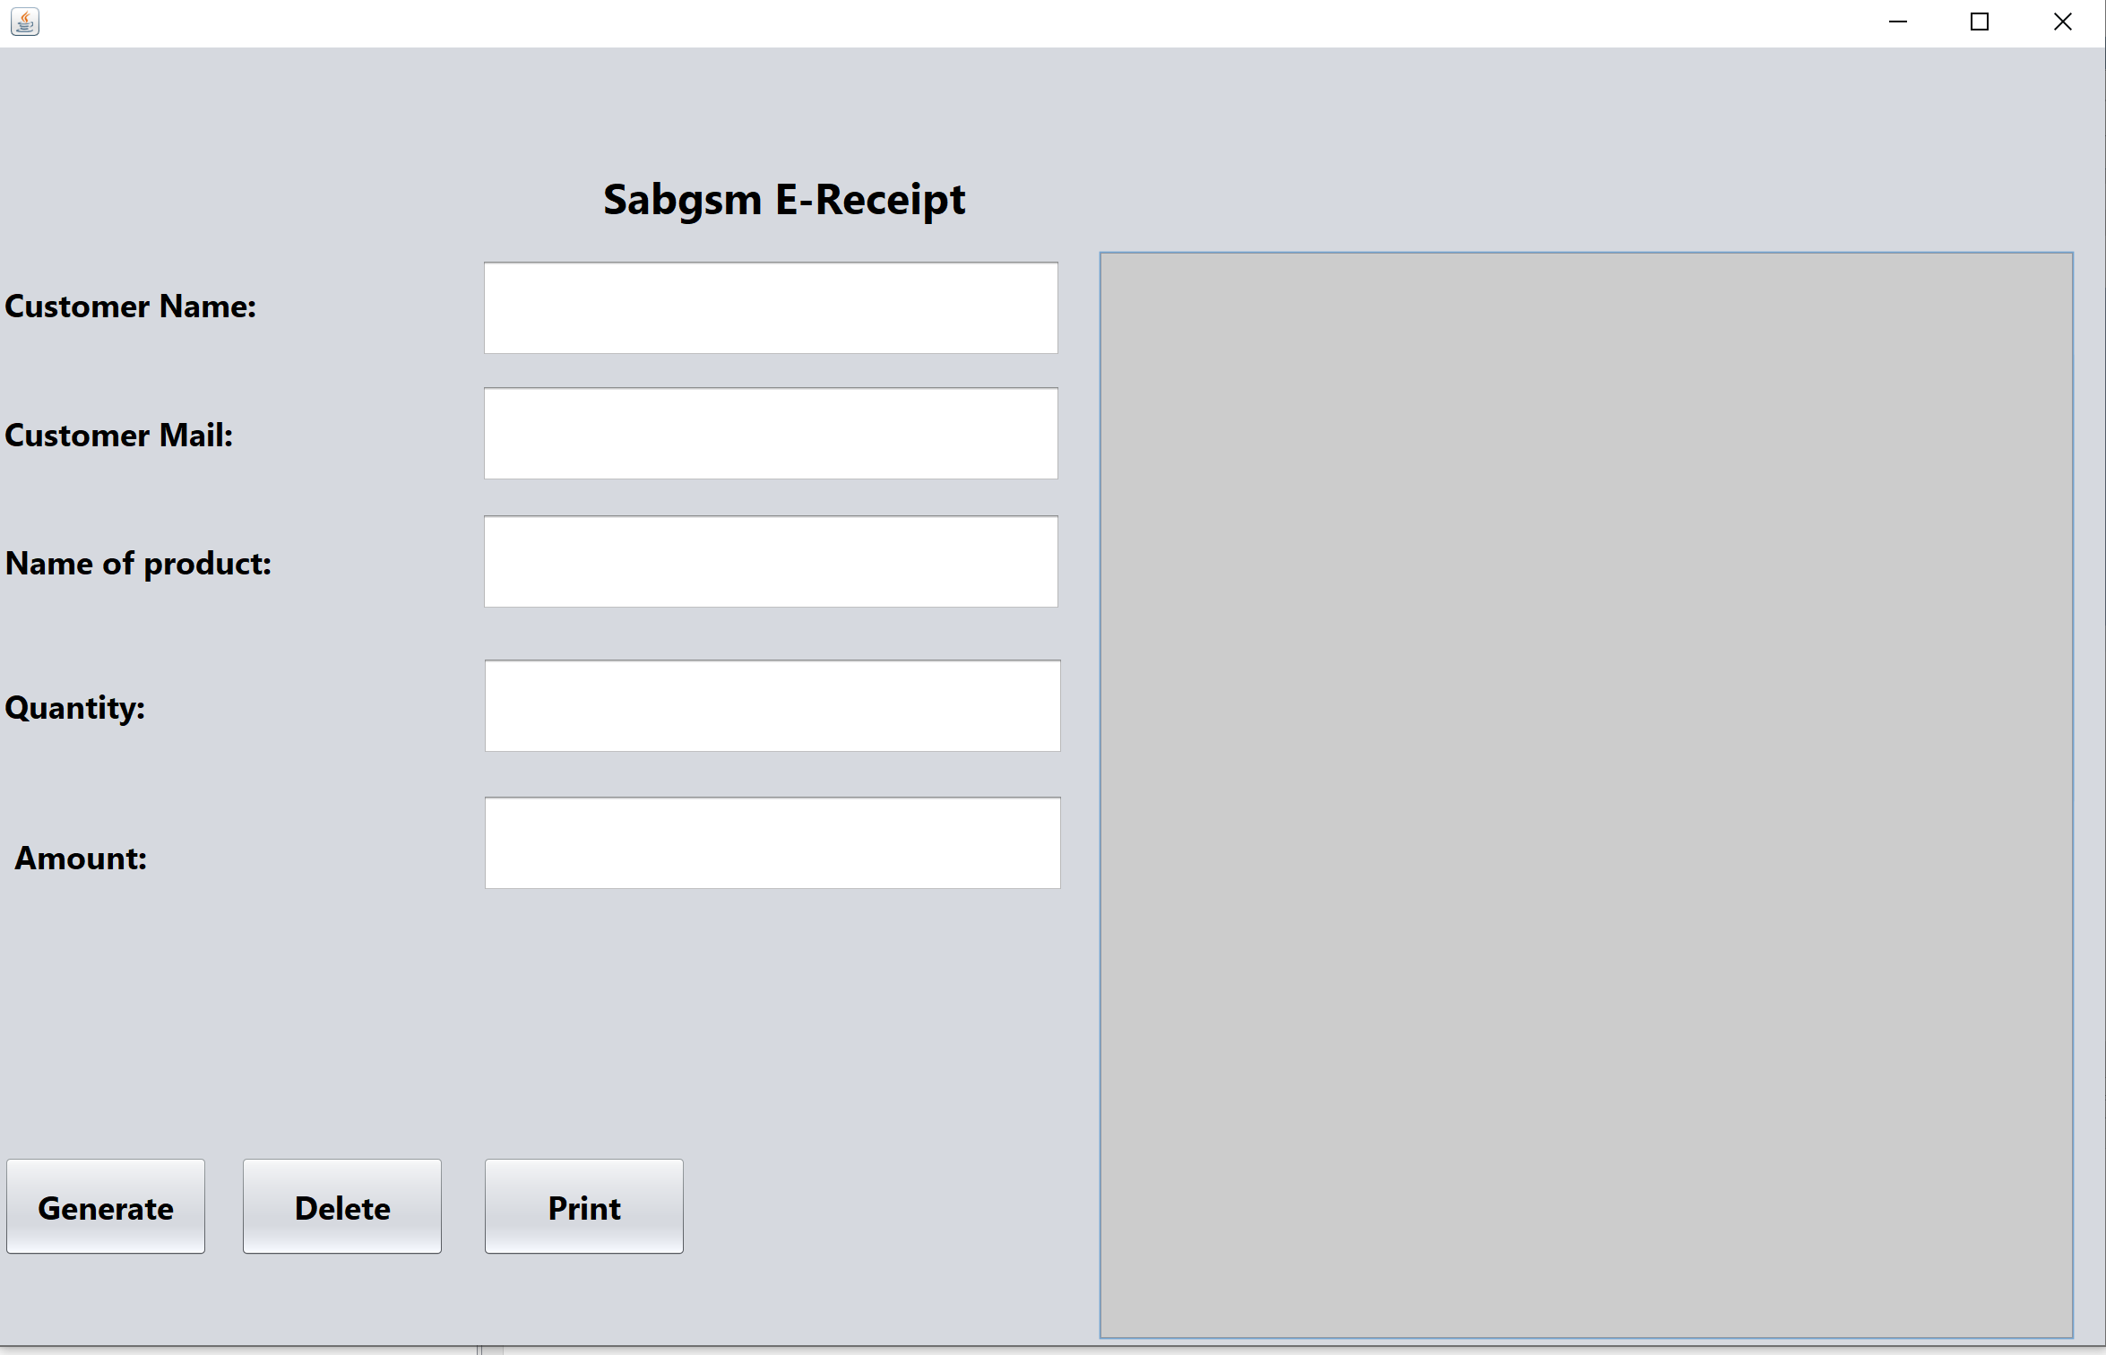

Slide 6
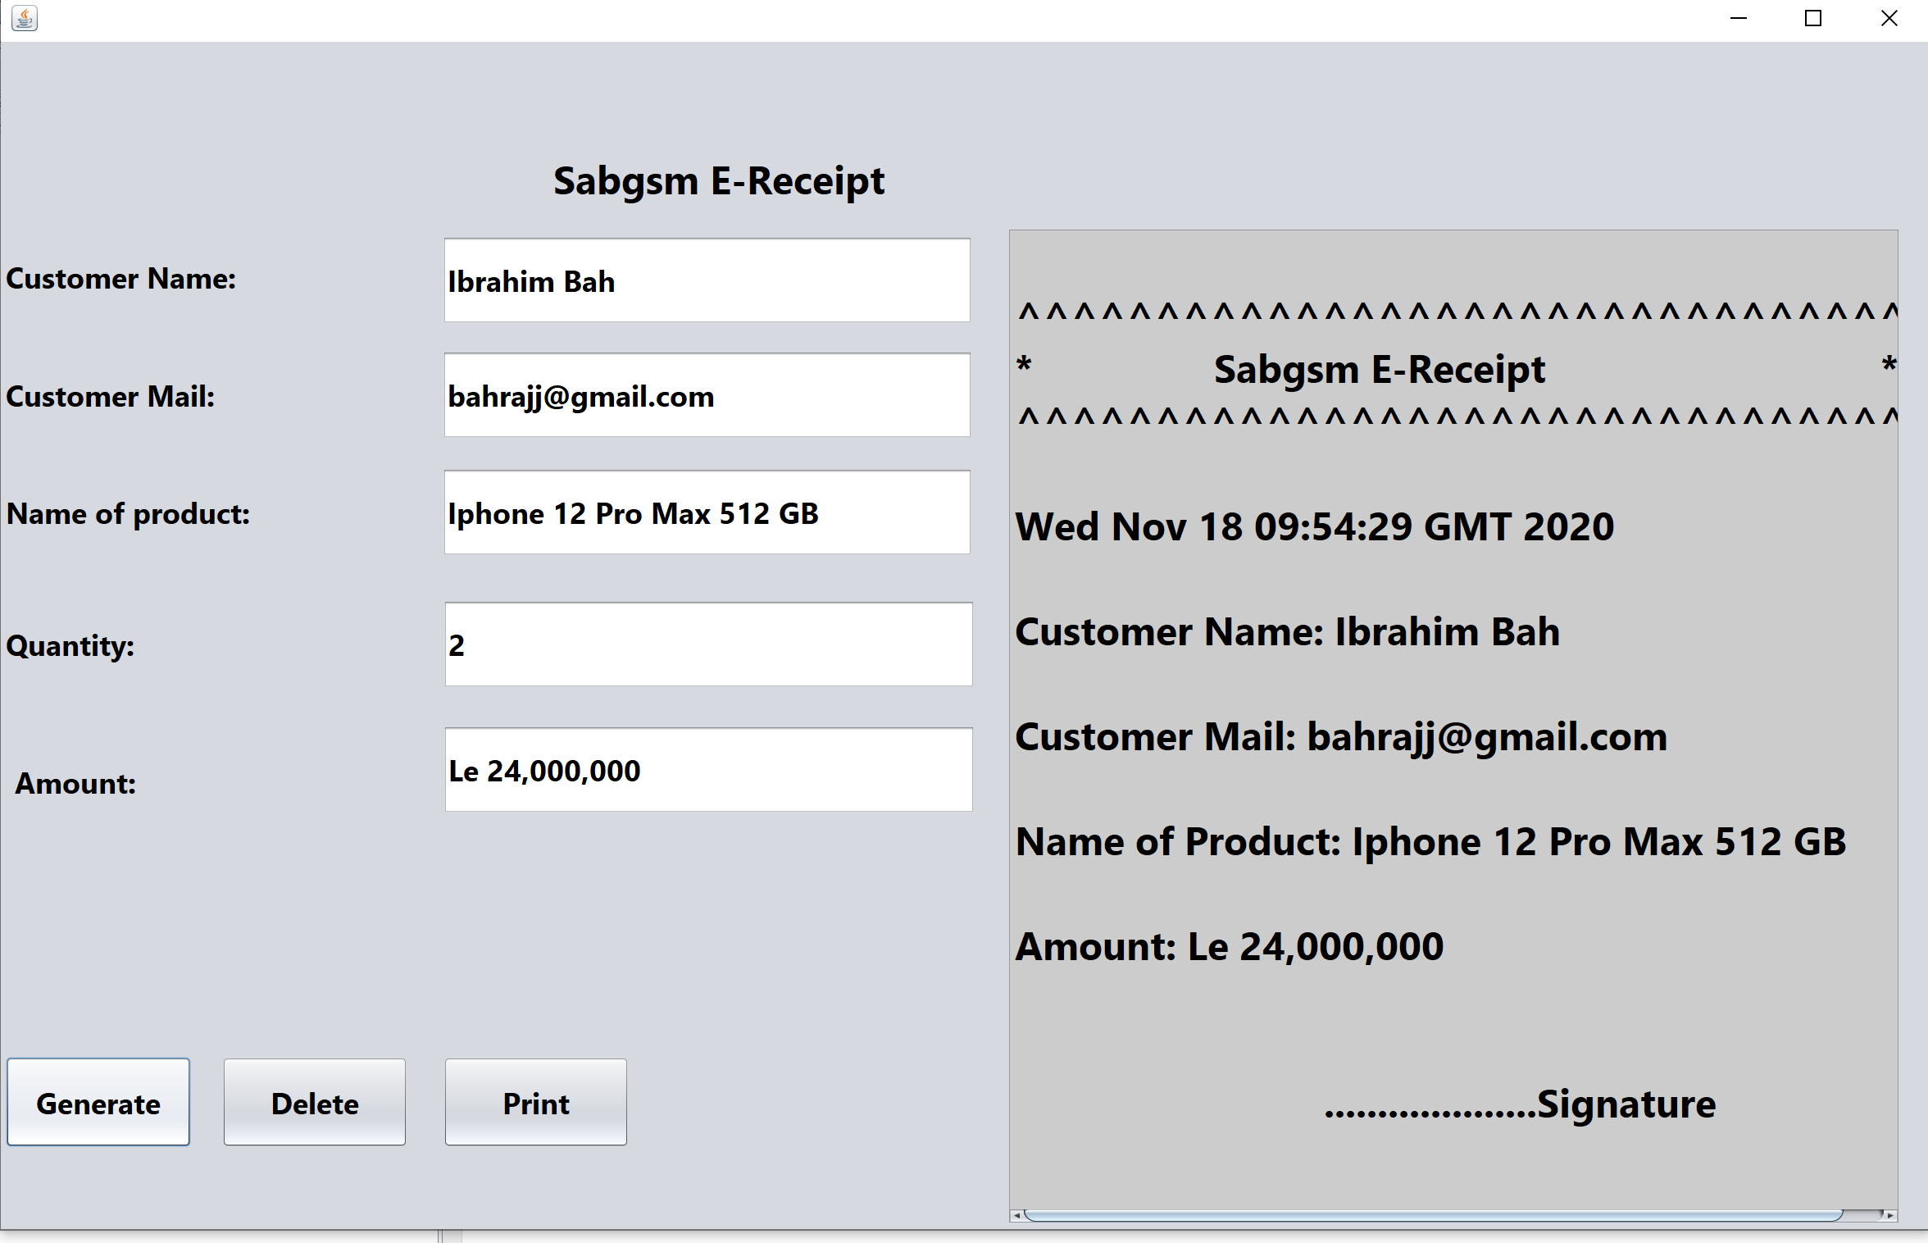

Slide 7
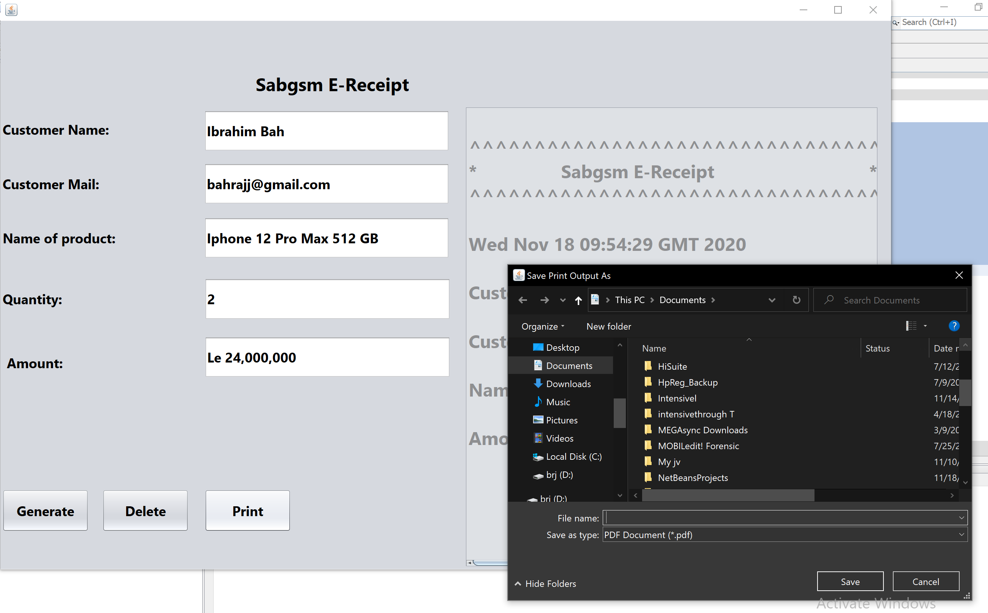
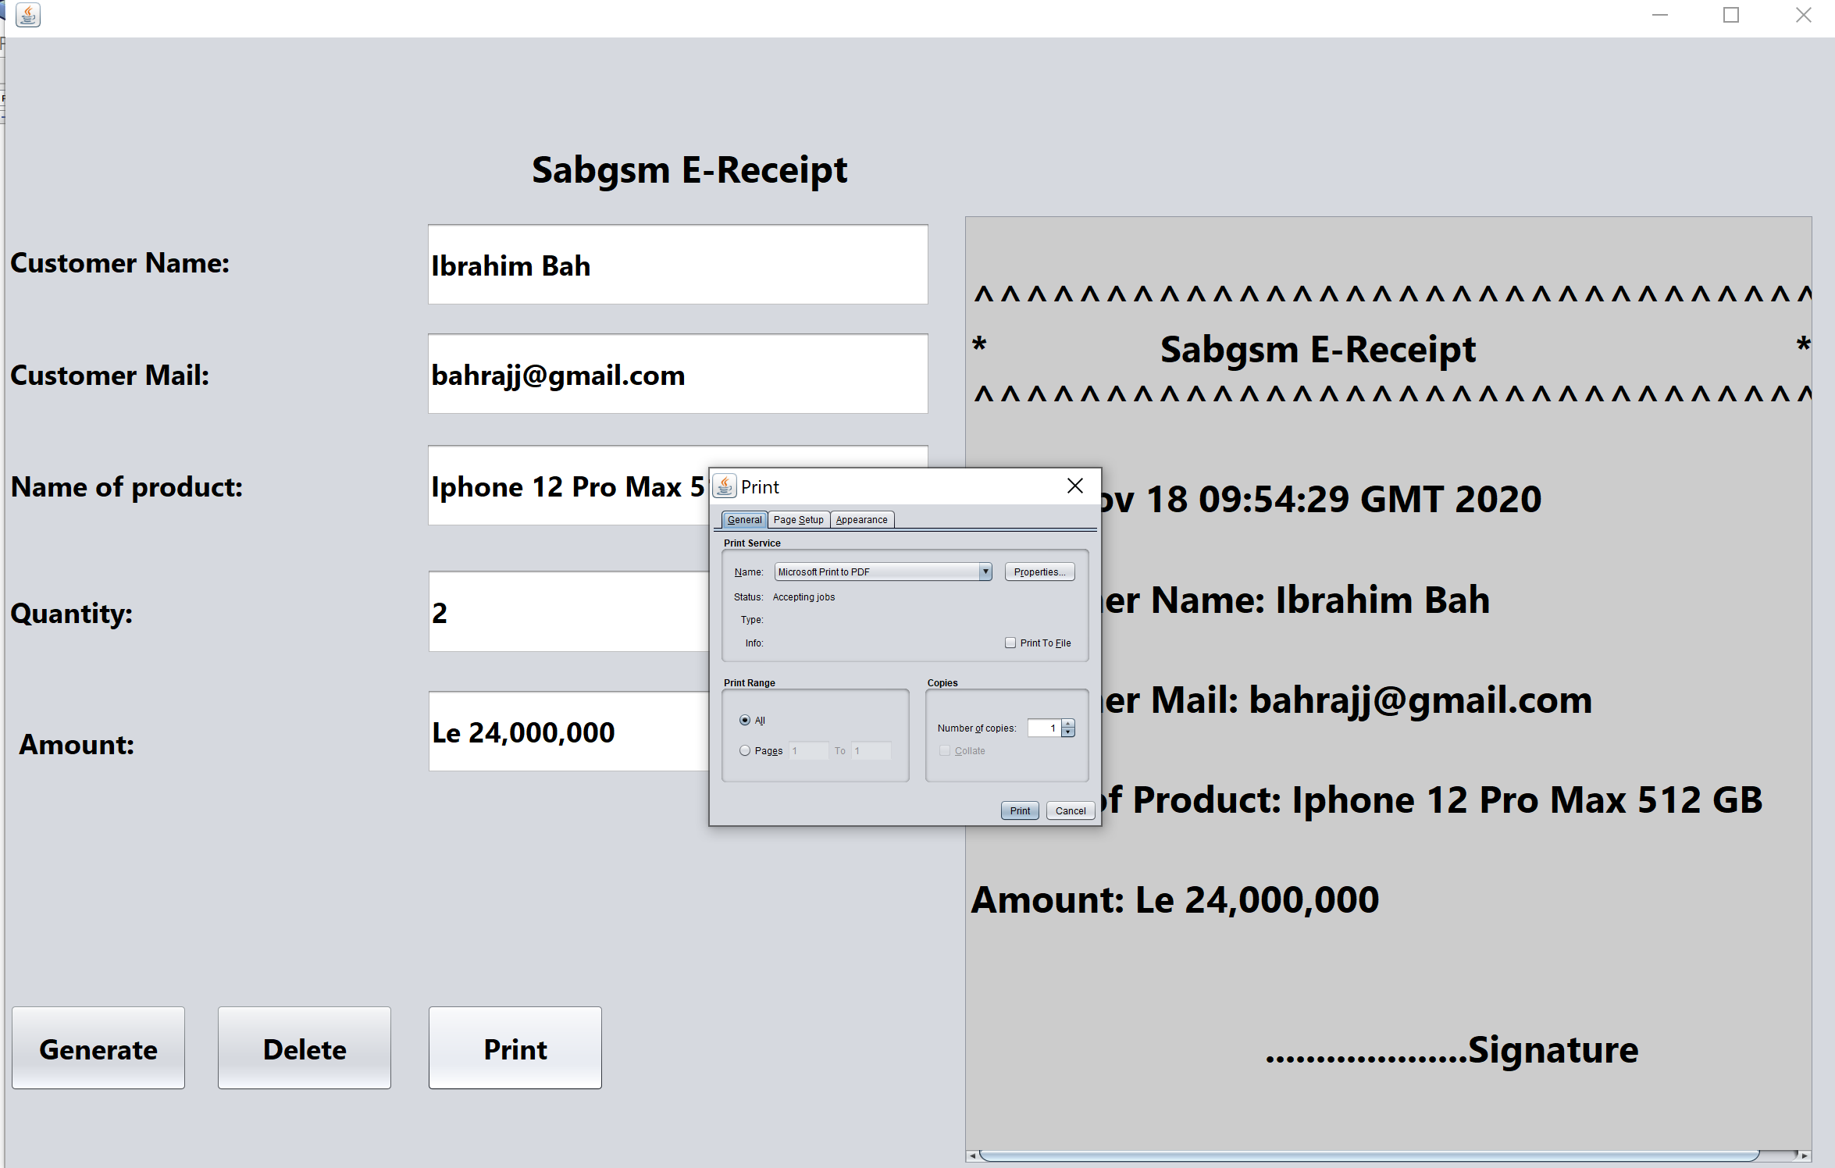

Slide 8
Future plans of Group 7
We intend to add the following:
Automation:
save details of existing user and copy details of new customers for future transactions.
Database:
to enforce the use of the automation
Versions:
to develop different versions and upgrades

Slide 9
Name | ID | Email
Ibrahim Bah | 21434 | bahrajj@gmail.com
Ibrahim Sowe | 21684 | raheemsowe@gmail.com
Abubakarr Kargbo | 21490 | kargbo.abubakarr.ka@gmail.com

Slide 10
Individual Contribution in %
Name | ID | Email | Contribution
Ibrahim Bah | 21434 | bahrajj@gmail.com | Worked on: Collected data and analysis of those data, Integration. Problem statement and Documentation 60%
Ibrahim Sowe | 21684 | raheemsowe@gmail.com | Documentation, Feasibility study, and Problem statement. Analysis 40%
Abubakarr Kargbo | 21490 | kargbo.abubakarr.ka@gmail.com | Documentation, Feasibility study, Problem statement Analysis 40%

